Slide 1
382N.1: Computer Architecture Fall 2018: Lecture 19
Dam Sunwoo
University of Texas at Austin
Arm Research

Slide 2
Announcements
Reminder: Lab #4 due this weekend
Problem Set #5 just posted
Due Nov 15 at 11:59pm (to help you with exam prep)
Reminder: Exam #2: Nov 19 (in class)
Reminder: No class on Nov 21 (day before Thanksgiving)

Slide 3
Recap and Outline
Recap
I/O
Bus
Interconnection Networks
Outline
Vector processors

Slide 4
Single instruction multiple data (SIMD)
sequencer
Local Mem
Local Mem
Local Mem
Local Mem
memory hierarchy

Slide 5
SIMD (vector style) – aka DLP (data-level parallelism)
sequencer
Local Mem
Local Mem
Local Mem
Local Mem
memory hierarchy

Slide 6
SIMD vs. Vector Processors
SIMD
Vector
PE0
PE1
PE2
PE3
LD
ADD
MUL
ST
Same op at same time
LD0
ADD0
MUL0
ST0
LD1
ADD1
MUL1
ST1
LD2
ADD2
MUL2
ST2
LD3
ADD3
MUL3
ST3
LD0
LD1
LD2
LD3
ADD0
ADD1
ADD2
ADD3
Time
MUL0
MUL1
MUL2
MUL3
ST0
ST1
ST2
ST3
Different op in same space
Different op at same time
Code
LD VR <- A[3:0]
ADD VR = VR + 1
MUL VR = VR * 2
ST A[3:0] <- VR
Same op in same space

Slide 7
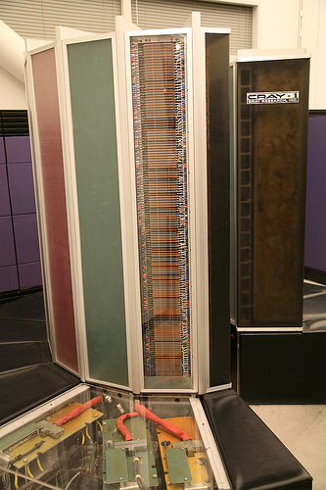
Cray-1 (1976)
http://www.flickr.com/photos/laughingsquid/102686307/

Slide 8
Cray-1
From Cray-1 paper (1977)

Slide 9
Cray-1 (1976)
V Regs
(64x64)
V Regs
(64x64)
V Regs
(64x64)
V Regs
(64x64)
V Regs
(64x64)
Vec Add
V Regs
(64x64)
V Regs
(64x64)
V Regs
(64x64)
Vec Logic
Vec Shift
Pop Cnt
FP Add
( (A_{h}) + j k m )
S0
S_{j}
FP Mul
Single Port
Memory
(320MW/sec)
16 banks of
64-bit word
+
8-bit SECDED
S1
S_{k}
FP Recip
S_{i}
S2
(A₀)
64
T Regs
S3
S_{i}
T_{jk}
S4
Int Add
S5
S6
Int Logic
S7
Int Shift
( (A_{h}) + j k m )
A0
Pop Cnt
A1
A_{i}
A2
A_{j}
(A₀)
64
B Regs
A3
A_{k}
Addr Add
B_{jk}
A4
A5
A_{i}
Addr Mul
A6
A7
64-bitx16
NIP
CIP
4 Instruction
Buffers
LIP
processor cycle 12.5 n seconds memory cycle 50 n seconds

Slide 10
Memory Initiation Rate
Memory speed must keep up with CPU speed!
Interleave memory banks
To maintain initiation rate of 1, the number of banks must be at least the ratio of memory to processor cycle time.
However, if processor make access in non-unit stride, it is possible to have bank conflicts.

Slide 11
Memory Initiation Rate
In general, effective bandwidth (relative to 1 bank) is
Number of banks / GCD(stride, number of banks)
Example: stride = 1, number of banks = 16, 16/1 = 16
Stride = 16, number of banks = 16, EB = 16/16 = 1
Stride = 8, number of banks = 16, 16/8 = 2
Stride = 3, number of banks = 16, 16/1 = 16
A performance-minded programmer will rearrange data to avoid bad strides (by padding etc)
Alternatively, prime number of banks is an hardware solution.
Only have most serious problem when accessing at stride exactly equal to the number of banks
Difficult to implement though.
Must do real divisions instead of shifts

Slide 12
Memory Bandwidth Needed
Pipelined vector add
read two arguments, write one result back each cycle
3 memory references / cycle
Cray-1, cycle time is 12.5ns (80MHz)
3W * 80MHz = 240 M Words / sec
each word, 64b
8B * 240M/sec ~= 2GB/sec (Cray-1 actually higher at 320MW/sec)
Extremely fast for the time, not too bad even today
Pentium 4, cycle time is 0.2778ns (3.6GHz)
3W * 3.6GHz = 10.8GW/sec
Each word, 64b
8B * 10.8G/sec = 86.4GB/sec
Pentium 4 has 800Mb/sec * 64b bus = 6.4GB/sec peak (never achievable)
Not very balanced

Slide 13
Performance of Cray-1
Memory bandwidth limiting factor for Cray-like vector machines
Cray-1 Peak Performance
240 MFlops
Cray-1 Sustained Performance
80 MFlops steady-state
Cray-1 Realistic Performance
20-30 MFlops, including scalar portions

Slide 14
Cray-1 Packaging
Shaped in a partial cylinder, 4.5’ in diameter, 6.5’ high
3 90-degree arc segments, 4 columns per segment
144 modules per column
2 circuit board per module with up to 144 IC’s each
modules are mounted on copper heat transfer plate
All plates are connected to vertical aluminum bars with pipes carrying freon
Plates are kept at 25 degree Celsius and IC’s run in the 50 degree range
2 25-ton compressors are needed

Slide 15
Cray-2 (1985)
16 gate arrays, sub-nanosecond delay ECL logic
14 Columns in 300-degree arc
112 cm high and 133 cm in diameter
All circuits are immersed in inert fluorocarbon
Power supplies and plumbing at the base of the machine

Slide 16
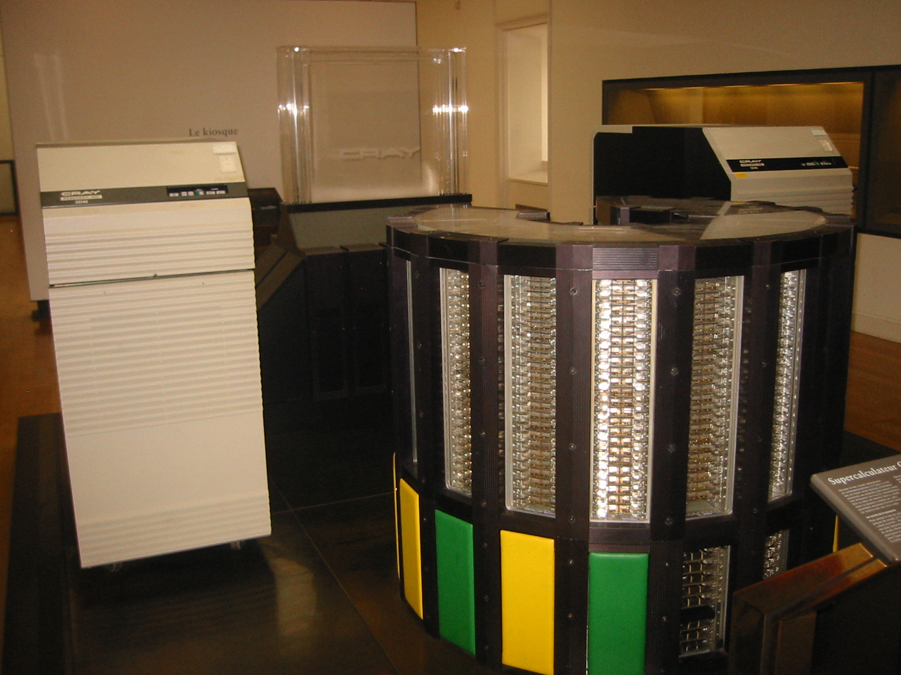
Cray-2 from Musee des Arts and Metiers, Paris, France (http://www.arts-et-metiers.net/)

Slide 17
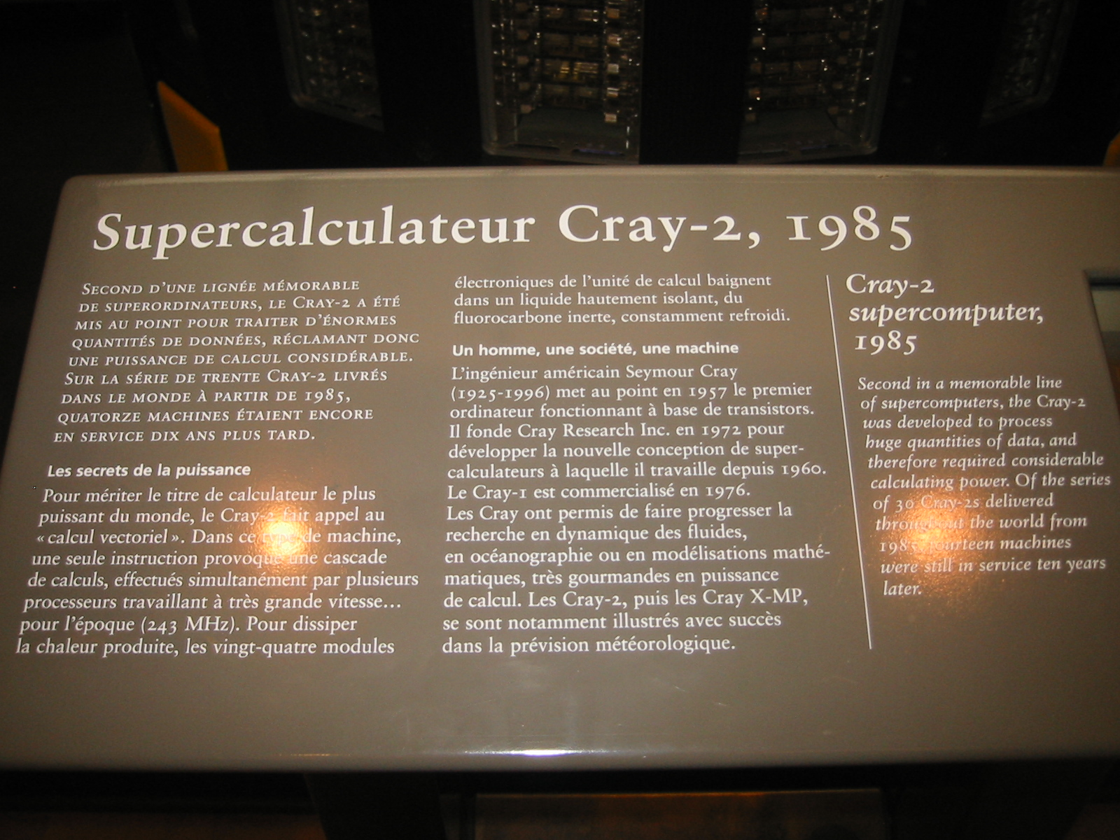
Cray-2

Slide 18
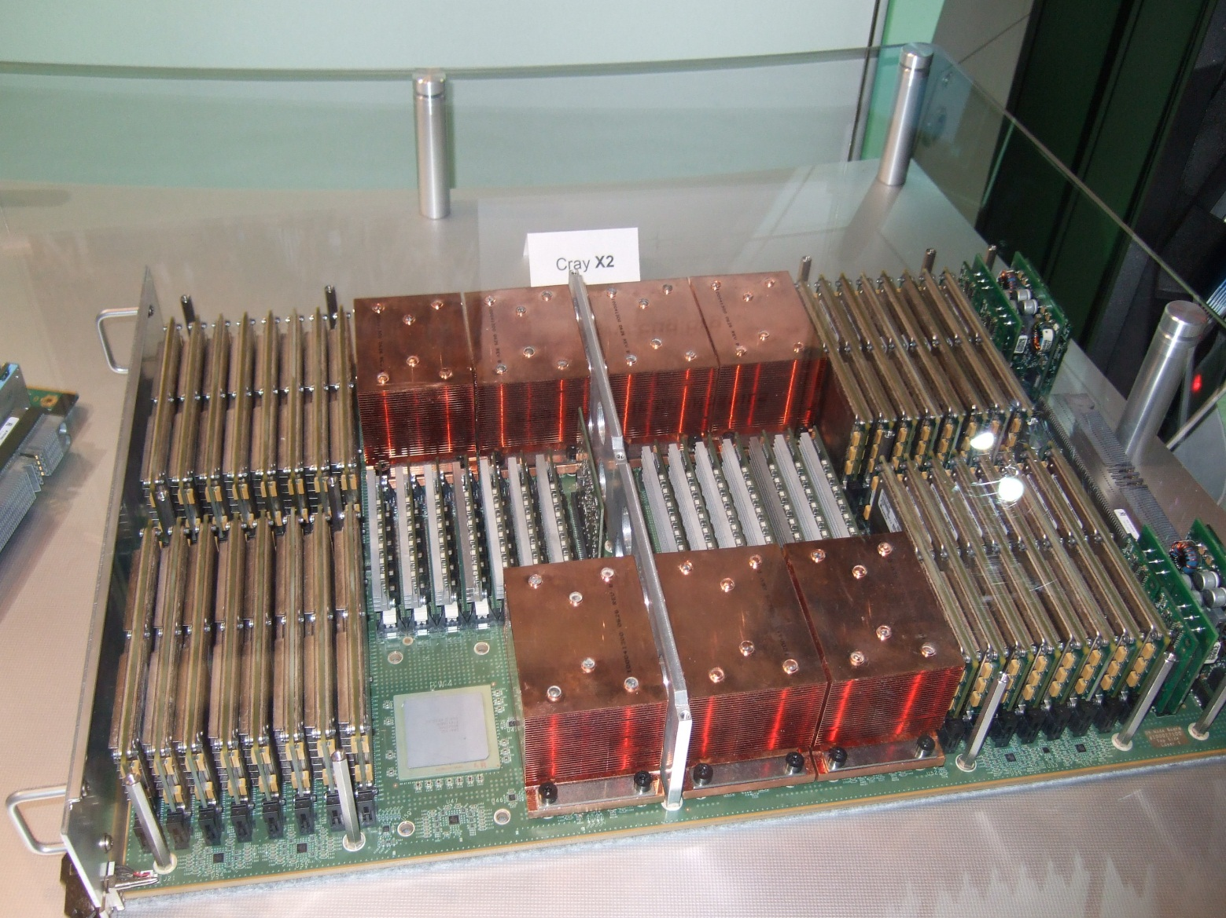
Modern Cray Boards: Cray X2 (Black Widow) (2007)
100 GFLOPS
“Fat Tree” interconnect

Slide 19
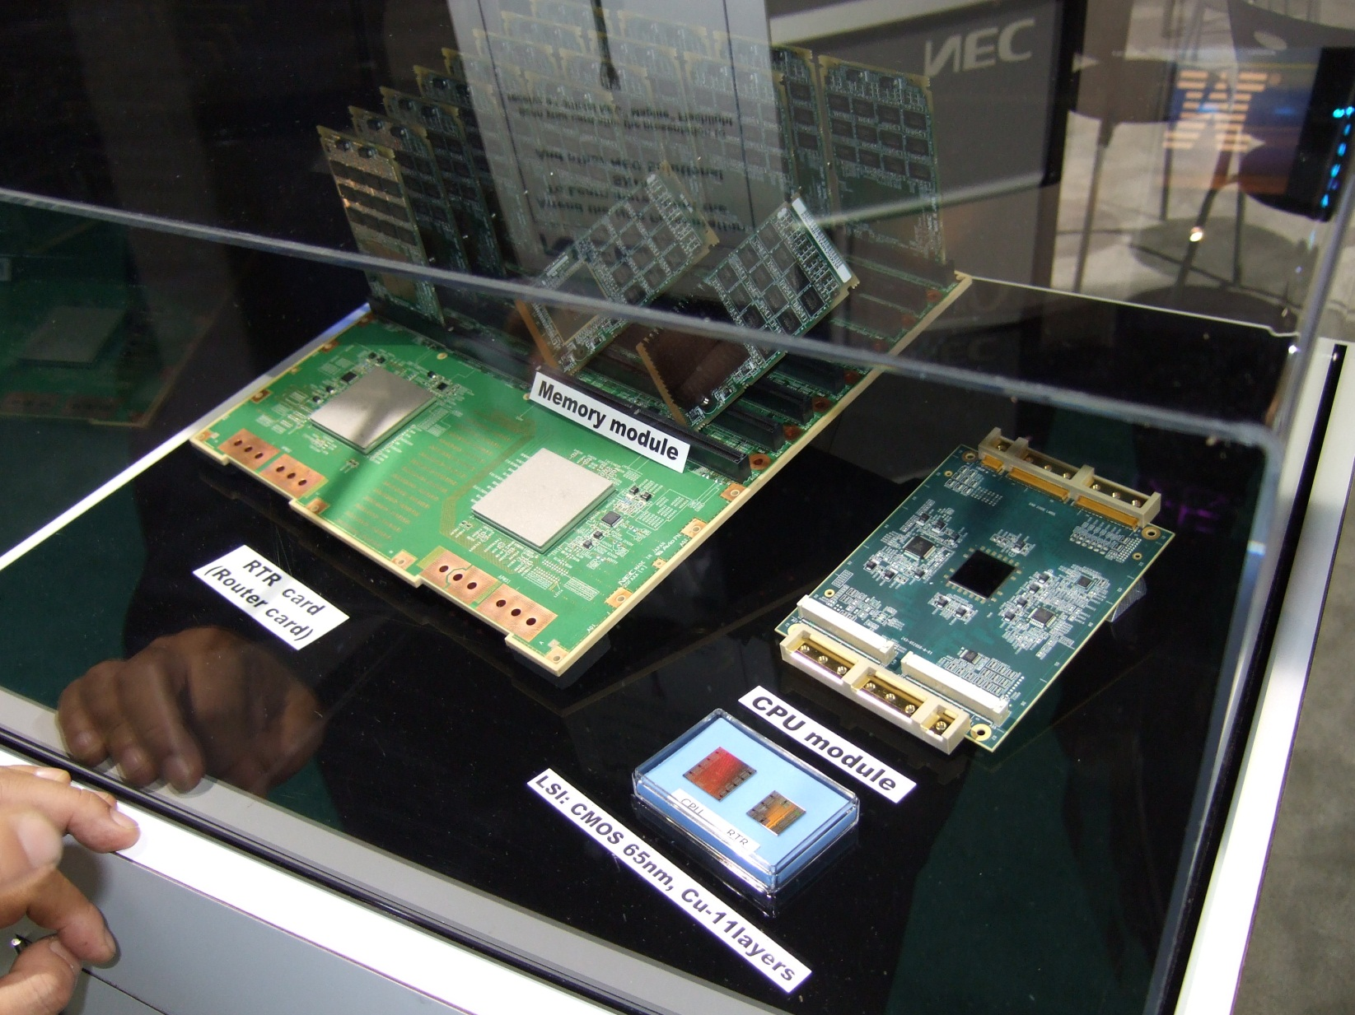
NEC SX-9 (100 GFLOPS, 256GB bandwidth) (2008)

Slide 20
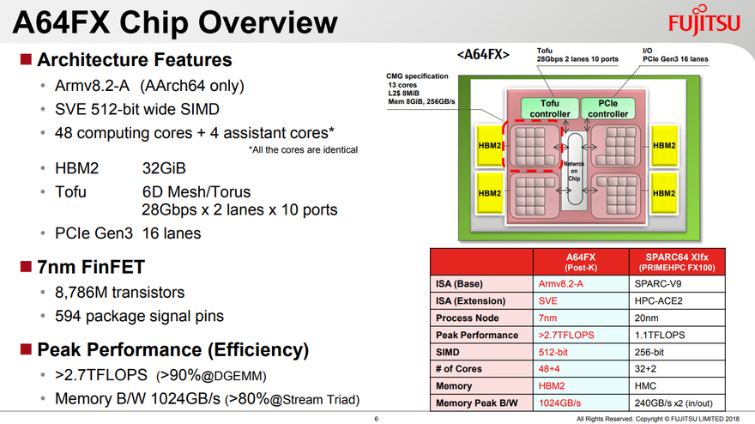
Post-K Supercomputer with Arm (2018)
slides from Fujitsu

Slide 21
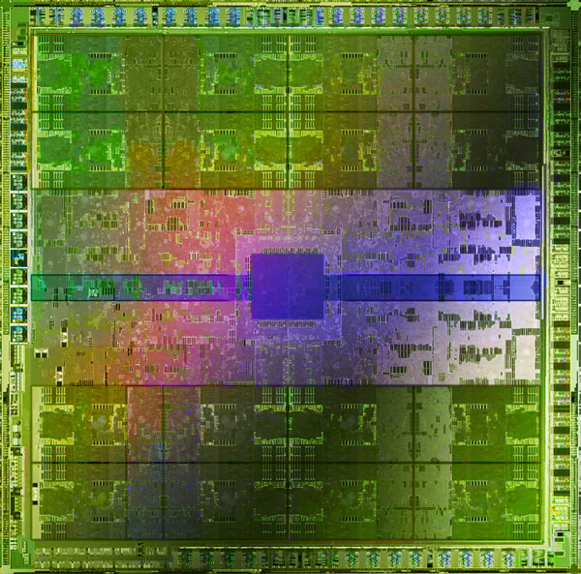
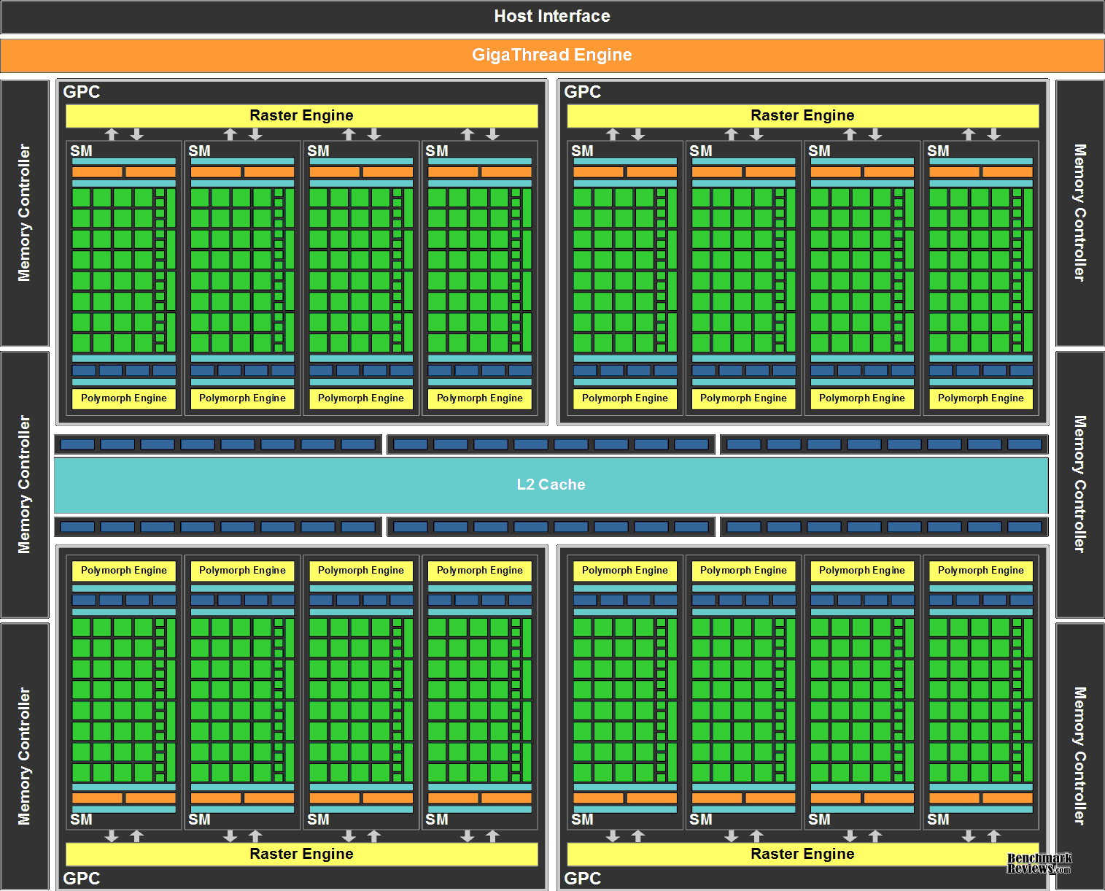
And why they are still important – GPUs
GPUs have >10X better performance and efficiency compared to CPUs

Slide 22
Vector Machine Organization
Typically contains separate vector unit and scalar unit
Still need to do scalar computation
Two classes (by memory access pattern)
Vector-register (vector analog of load-store architectures): all memory accesses go to vector registers and arithmetic operations are between vector registers
Memory-memory: vector operands and target are in memory

Slide 23
Implementing Vector Ops
A
A
A
A
Many identical arithmetic units
Data parallel
Pros? Cons?
Several highly pipelined arithmetic units
Identical
Heterogeneous
Pros? Cons?
Mix?
(Vector Length = 4) in all cases here
Op
Op
Op
Op
(SIMD)
B
B
B
B
C
C
C
C
A
A
A
A
B
B
B
B
Op
(4-deep
Pipeline)
A
A
B
B
A
A
B
B
C
C
C
C
Op
Op
C
C
C
C
Vector Lane / Pipe

Slide 24
Vector Machine: Performance Basics
The contributions to run time of an instruction are
startup-time: depth of the pipeline
initiation rate: rate at which instructions enters the pipeline
# lanes
Under simplistic assumptions:
The time to complete a vector operation of length n is
startup-time + (n-1) / initiation rate

Slide 25
Vector Speedup
Given 75% vectorizable code and vector/scalar performance ratio of 5:1
What is the single node speedup through vectorization?
Amdahl’s Law
Speedup = T_{ori}/T_{new}
T_{new} = (.75 * 1/5) + (.25 * 1/1) = 0.4
Therefore, speedup = 1/0.4 = 2.5

Slide 26
Goal: don’t stop the pipeline
What about control flow?
Branches
Address calculation
…
What happens when one vector instruction finishes?

Slide 27
But what about actual branches?
Scalar code executes on separate “pipe”
Control runs ahead of vector unit
Resolve branches and addresses decoupled from vector pipe
Only stop if depend on vector results!

Slide 28
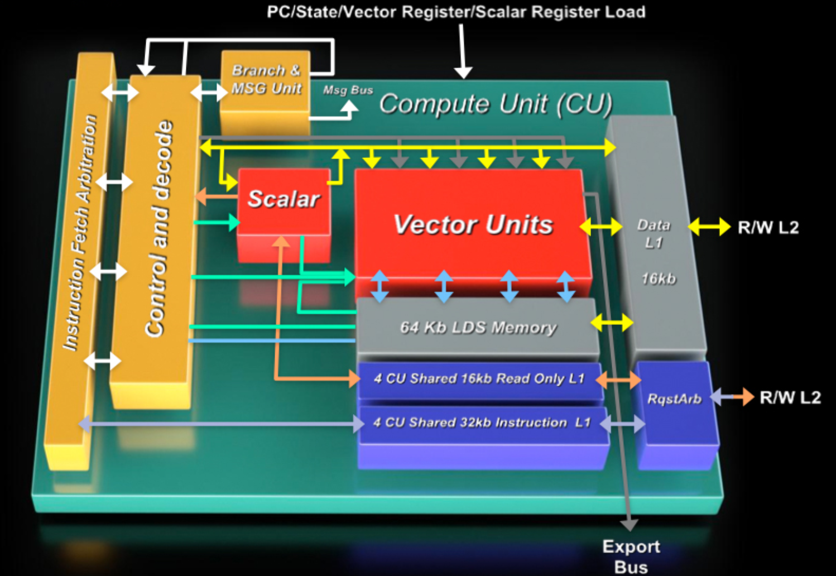
But what about actual branches?
Scalar code executes on separate “pipe”
Control runs ahead of vector unit
Resolve branches and addresses decoupled from vector pipe
Only stop if depend on vector results!
[AMD Fusion System Architecture]

Slide 29
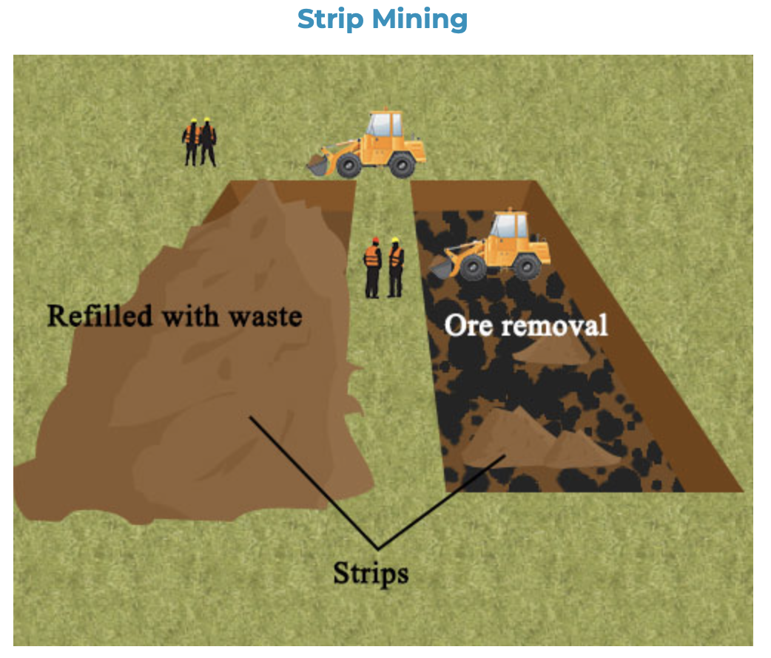
Strip-Mining
Analogy from mining
Cut rock above an ore deposit in long ‘strips’
This uncovers ore, which is then removed
When the deposits in a strip are exhausted, another strip is dug beside it
The ‘overburden’ (waste removed to access the ore) from each strip is used to fill the previous one

Slide 30
Strip-Mining in Vector Processing (aka Loop Sectioning)
The vector length required by the program is generally different than full vector length of the machine
Typically, vector machine allows the program to specify the length of the operation in a hardware register
Thus to operate on a large vector (VL > MVL), one first performs a partial vector operation, followed by N number of full length operations. (Strip-Mining)
Introduces additional overhead (branches and controls) to overall runtime. (estimated vector performance must account for this)
Cray and Fujitsu vector machines rely on compiler to strip-mine
Hitachi S810/20 implements strip mining in hardware

Slide 31
Strip Mining
ALU

Slide 32
Status and Condition Codes
Scalar machines
Record status in special registers and provide instructions for test and branch
Provide test for special values
Vector machines
Vector of condition codes
One vector per condition code? Wasteful
Possibilities
Record first anomaly, then number of same
Provide vector test instructions for equal, <, >, etc.
Define weird vector values for overflow and other exceptions

Slide 33
Estimating Performance
T_{element} : time per macro op for a sequence of ops
T_{loop} : strip mining cost per loop iteration
T_{start} : startup cost per loop iteration
T_{base}: the initial cost to setup the whole operation
MVL: Machine Vector Length
N: number of elements
Total runtime
T_{n} = T_{base} + ceiling(n/MVL) * (T_{loop} + T_{start}) + n * T_{element}
Average time per element is T_{n}/n which accounts for the real-life overhead to run the code

Slide 34
Vector Instruction Design
Two options
Design for highly overlapped execution of vector instructions using multiple pipelines
results from one pipeline can be feed into another pipeline as operands using “chaining”
pipeline scheduling done by hardware
No overlapped vector instructions
opcode determines static scheduling of pipelines
proliferation of opcodes: VectorAdd&Mul, etc

Slide 35
Chaining
Similar to bypassing from basic RISC pipeline
Removes interlocks between interdependent instructions.
Chaining connects the output of one functional unit to the input of the next.
Can chain to/from memory, ALUs, etc
Essentially, pipelining

Slide 36
Example Code
Scalar
For I = 0 to 49
C[i] = (A[i] + B[i]) / 2
Vector
VLN = 50 ; 1
VST = 1 ; 1
V0 = A[0..VLN-1] ; 11 + VLN - 1
V1 = B[0..VLN-1] ; 11 + VLN - 1
V2 = V0 + V1 ; 4 + VLN - 1
V3 = V2 >> 1 ; 1 + VLN - 1
C[VST...VST+VLN-1] = V3 ; 11 + VLN – 1
Performance
Assume LD/ST takes 11 cycles, ADD 4 cycles, SHIFT 1 cycle (pipelined)
Compare no-chaining, chaining, chaining + 2 read/1 write port

Slide 37
Scalar Performance
304 dynamic instructions
Scalar code
R0 = 50 ; 1
R1 = A ; 1
R2 = B ; 1
R3 = C ; 1
X: R4 <- MEM[R1++] ; 11 (auto-increment)
R5 <- MEM[R2++] ; 11
R6 = R4 + R5 ; 4
R7 = R6 >> 1 ; 1
MEM[R3++] = R7 ; 11
DECBNZ R0, X ; 2 (decrement and branch if not zero)
Perf with 1 mem bank and in-order:
4 + 50*40 = 2004 cycles
Perf with 16 mem banks / in-order:
4 + 50*30 = 1504 cycles
Why 16 banks?

Slide 38
Vector with No-Chaining Performance
285 cycles
VLN = 50 ; 1
VST = 1 ; 1
V0 = A[0..VLN-1] ; 11 + VLN - 1
V1 = B[0..VLN-1] ; 11 + VLN - 1
V2 = V0 + V1 ; 4 + VLN - 1
V3 = V2 >> 1 ; 1 + VLN - 1
C[VST...VST+VLN-1] = V3 ; 11 + VLN – 1

Slide 39
Vector with Chaining Performance, 1 Memory Port
182 cycles
V0 (Load)
V1 (Load)
V2 (Add)
VLN = 50 ; 1
VST = 1 ; 1
V0 = A[0..VLN-1] ; 11 + VLN - 1
V1 = B[0..VLN-1] ; 11 + VLN - 1
V2 = V0 + V1 ; 4 + VLN - 1
V3 = V2 >> 1 ; 1 + VLN - 1
C[VST...VST+VLN-1] = V3 ; 11 + VLN – 1
V3 (Shift)
C (Store)

Slide 40
Chaining, 2 Load/1 Store Ports
79 cycles
V0 (Load)
V1 (Load)
V2 (Add)
VLN = 50 ; 1
VST = 1 ; 1
V0 = A[0..VLN-1] ; 11 + VLN - 1
V1 = B[0..VLN-1] ; 11 + VLN - 1
V2 = V0 + V1 ; 4 + VLN - 1
V3 = V2 >> 1 ; 1 + VLN - 1
C[VST...VST+VLN-1] = V3 ; 11 + VLN – 1
V3 (Shift)
C (Store)

Slide 41
Vector Mask Control
Example:
loop: if a[i] then b[i]=a[i]+b[i]
goto loop
The conditional statement can be achieved by using “vector mask” control. VM is a bit mask of the length of the MVL
When VM is used, only the operation on positions corresponding to bits set in the VM are executed.
All are executed, only some are not propagated
Usage: compressing, conditional execution

Slide 42
Memory Specification
Which n locations in memory contain vector?
contiguous
need to specify base and length
memory interleaving works well
column of matrix (stored in row-major order)
base, length, stride
address generation must perform add
stride multiple of interleave factor?
diagonal of matrix
stride increases by one each time

Slide 43
Sparse Addressing Patterns
Sparse address patterns can arise due to
data dependent operations (conditionals)
vectors where most of the elements are zero
indirect table lookup
Techniques for sparse addressing
associate bit-vector or index-vector with vector
use bit or index vector to perform operations like selective store, compression, expansion

Slide 44
Scatter / Gather
Scatter / Gather operations often implemented in hardware to handle sparse matrices
Loads and stores use an index vector which is added to the base register to generate the addresses
Functional Description:
Gather
for (i=0; i<N; ++i)
x[i] = y[ idx[i] ];
Scatter
for (i=0; i<N; ++i)
y[ idx[i] ] = x[i];

